Slide 1

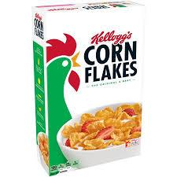

Find cereal &
add to cart
Obtain Cart
Checkout
Time taken = 3 units
…
…
…

